Slide 1

Animal Recognition – Classification by Using Features
By Asil Fawalha & Waiyat Hamdani

Slide 2
Specific Aims/Overview
Animal classification technology is a process or classification technique that identifies animal kinds in artificial intelligence.
Animal classification experiment is done by using a set of features based on a dataset for 101 animals.
The main goal of the project is to classify the animal from any given dataset, and surely based on features.

Slide 3
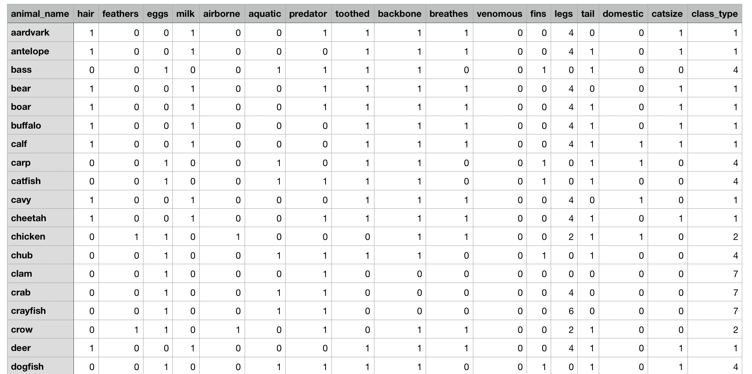
Data
The purpose for this dataset is to be able to predict the classification of the animals, based upon the variables.
This dataset consists of 101 animals from a zoo.csv.
There are 16 variables with various traits to describe the animals.
The 7 Class Types are: Mammal, Bird, Reptile, Fish, Amphibian, Bug and Invertebrate

Slide 4

Features
Hair | Backbone
Feathers | Breaths
Eggs | Venomous
Milk | Fins
Airborne | Legs
Aquatic | Tail
Predator | Domestic
Toothed | Catsize

Slide 5
Methodology
Importing libraries
Importing dataset
Extracting features list from dataset
Splitting dataset
Distribution of classes
Distribution in test set
Training decision tree classifier
Accuracy and classification report of classifier
Confusion matrix
Decision tree visualization

Slide 6
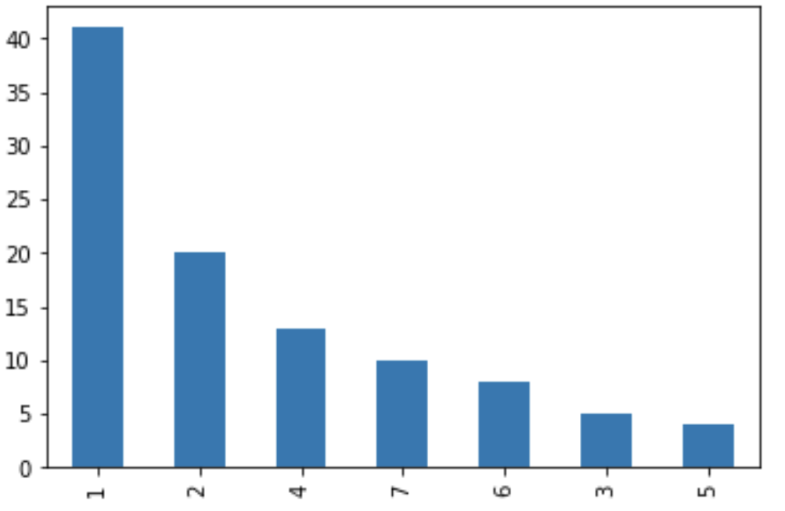
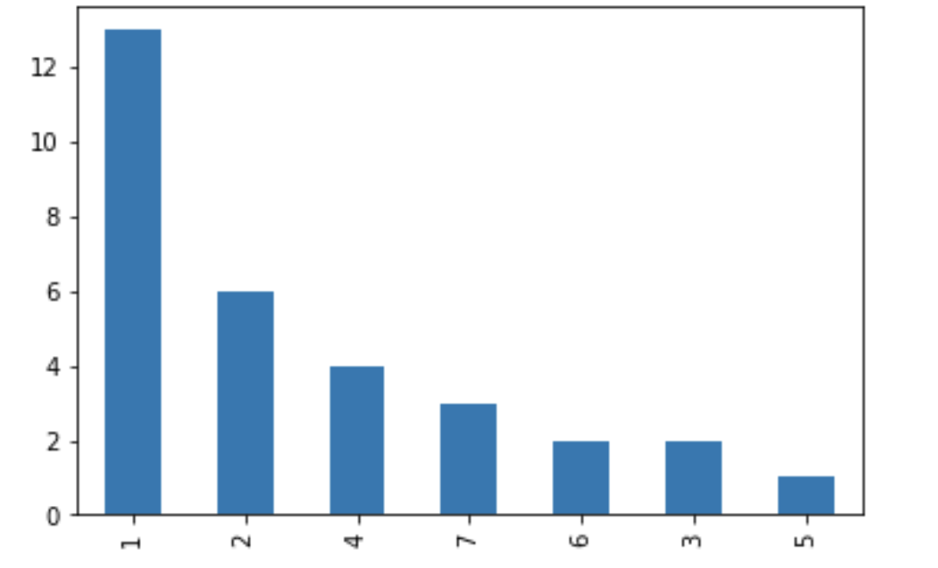
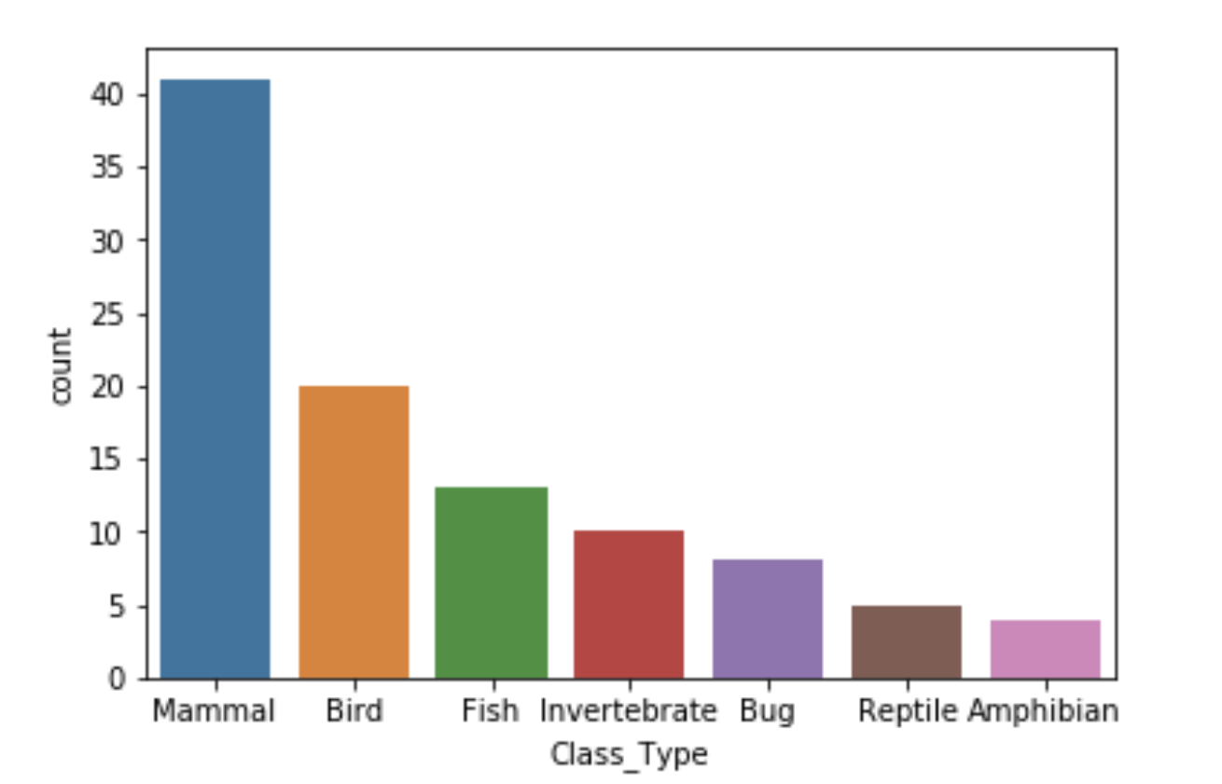
Methodology- Splitting Dataset
Distribution of classes
Distribution in test set

Slide 7
Experiment and Results- Accuracy and Classification Report
 | Precision | Recall | F1-score | Support
1 | 1.00 | 1.00 | 1.00 | 13
2 | 1.00 | 1.00 | 1.00 | 6
3 | 1.00 | 0.50 | 1.67 | 2
4 | 1.00 | 1.00 | 1.00 | 4
5 | 1.00 | 1.00 | 1.00 | 1
6 | 1.00 | 1.00 | 1.00 | 2
7 | 0.75 | 1.00 | 0.86 | 3
Accuracy |  |  | 0.97 | 31
Macro Average | 0.96 | 0.93 | 0.93 | 31
Weighted Average | 0.98 | 0.97 | 0.96 | 31
Testing Accuracy of the Experiment: 0.967741935483871 - 96.77%

Slide 8
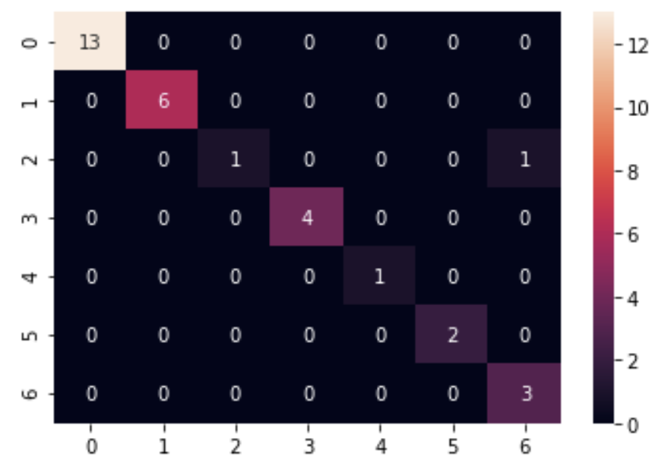
Experiment and Results- Confusion Matrix

Slide 9
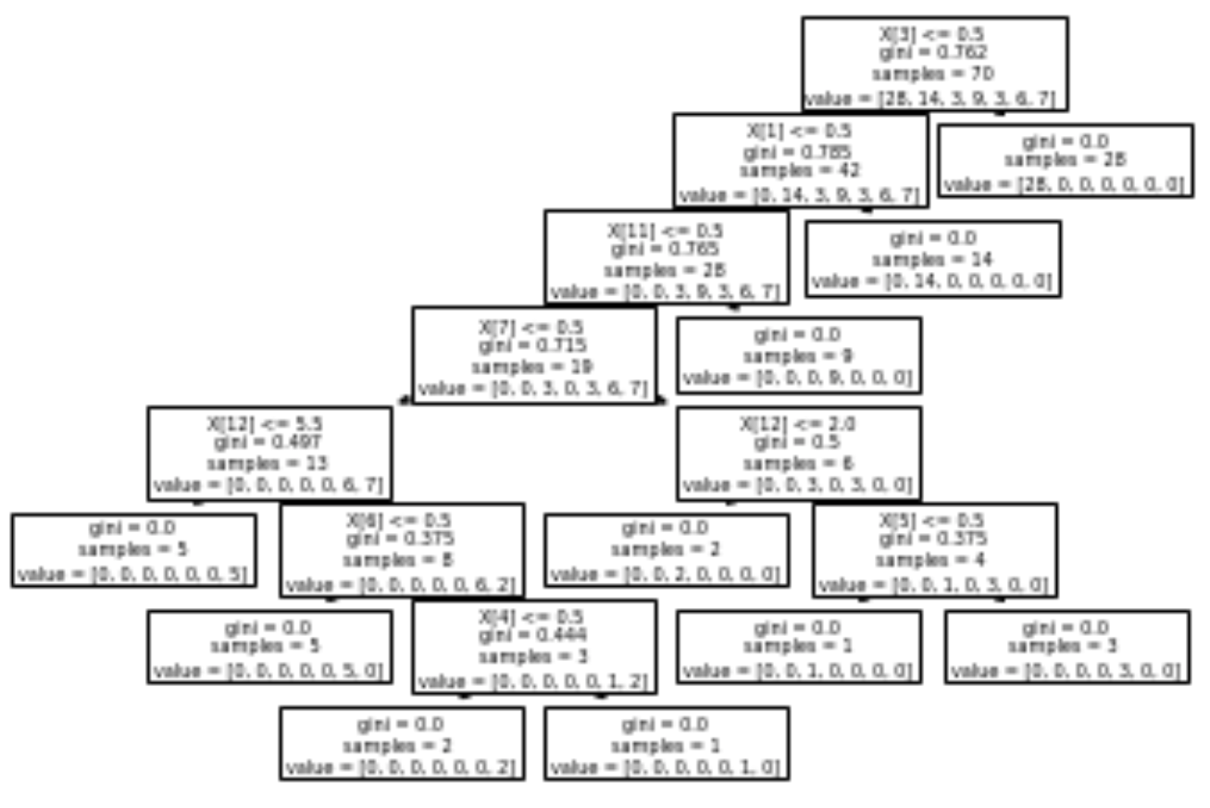
Experiment and Results- Decision Tree Visualization

Slide 10
Conclusion
So, after we applied decision tree algorithm to a dataset that contains 101 animals, we tested the dataset with the 16 features, 70 animals for training and 31 animals for testing.
We came up with a breakdown of which animals are in which type.
We came up with 7 classes, each class has a group of animals that could live in the same place:
Class 1 group is for mammal.
Class 2 group is for bird.
Class 3 group is for reptile.
Class 4 group is for fish.
Class 5 group is for amphibian.
Class 6 group is for bug.
Class 7 group is for invertebrate.

Slide 11
References
https://stackabuse.com/decision-trees-in-python-with-scikit-learn/
https://www.kaggle.com/uciml/zoo-animal-classification#zoo.csv

